Slide 1
MEEt
3rd October 2020

Slide 2
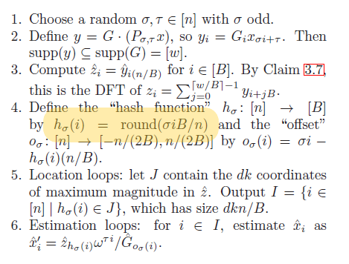
Error Found
1) The hash functions works for only sigma = 1. Any other random value will not result in a proper mapping

Slide 3
RESULTS

Slide 4
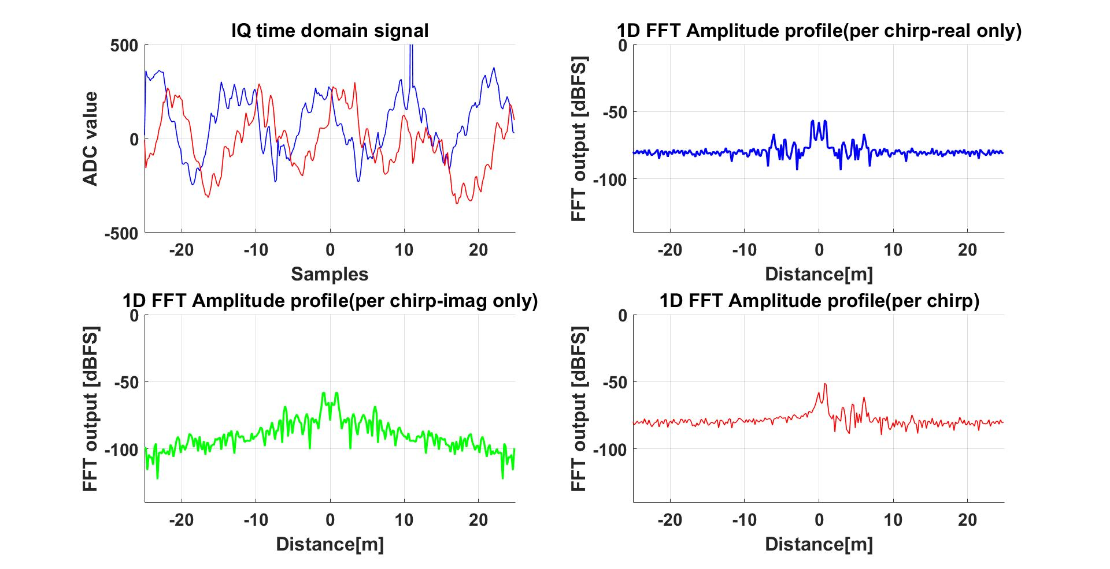
FFT of One chirp(using inbuilt functions)
Window Function on Next Slide

Slide 5
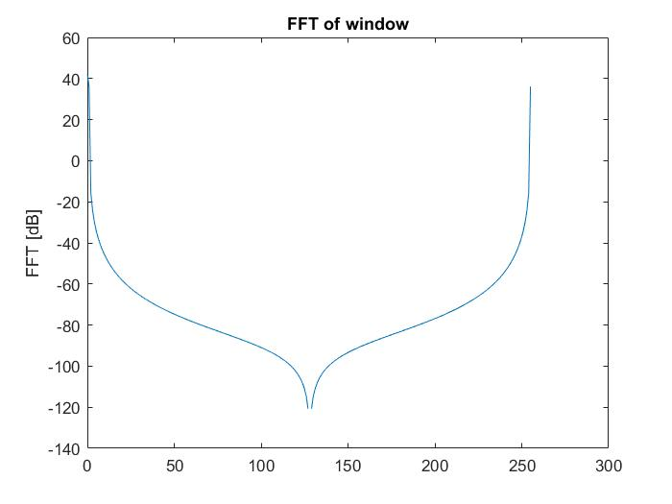
Hanning WiNDOW

Slide 6
COMMON WINDOW FUNCTIONS
OUTPUT COMPARISON USING COMMON WINDOW FUNCTIONS

Slide 7
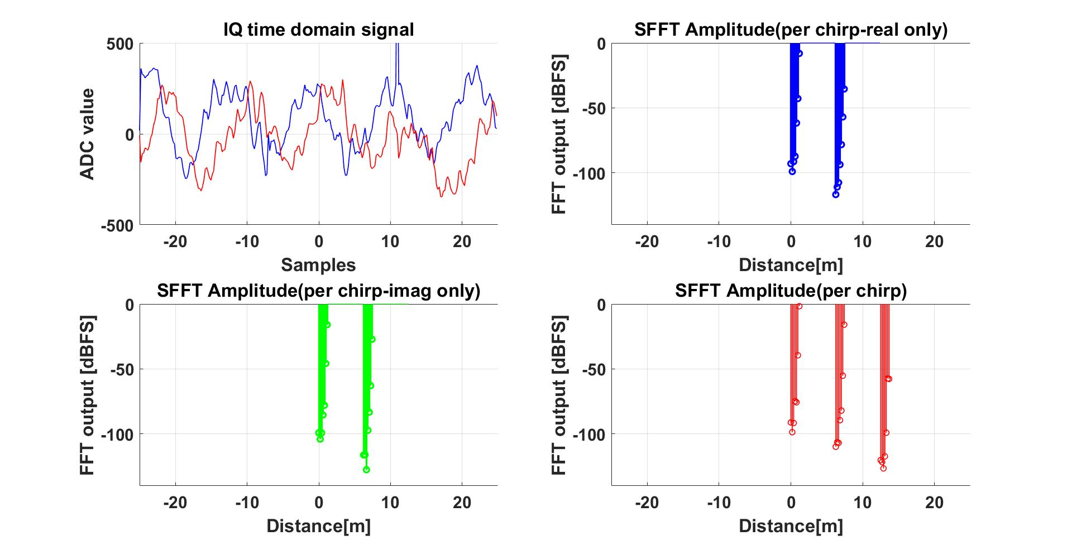
SFFT Algorithm (Box Car conv. Dolph Chebyshev window function)
Window Function on Next Slide

Slide 8
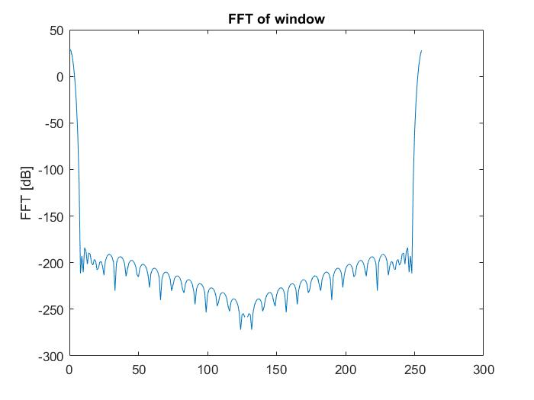
Window (Dolph Chebyshev conv. With box car)

Slide 9
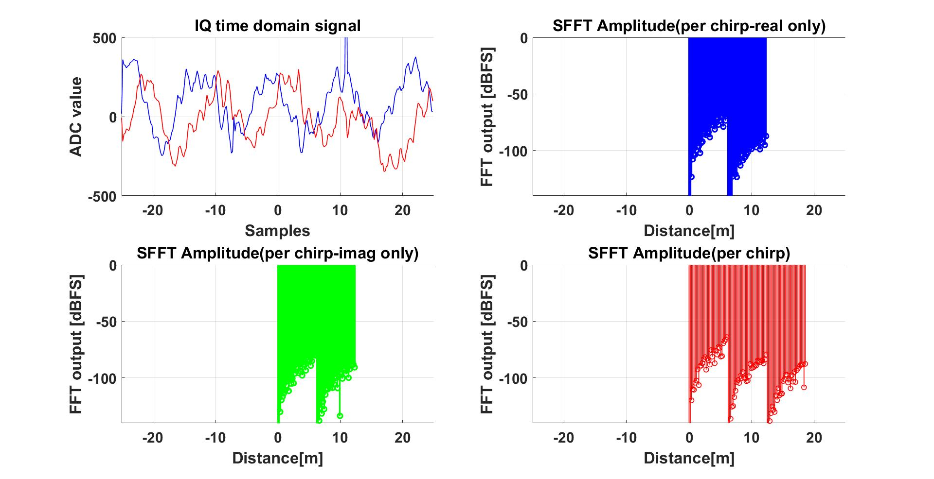
SFFT Algorithm (HANNING window function)
Window Function on Next Slide

Slide 10
HANNING WINDOW FUNCTION

Slide 11
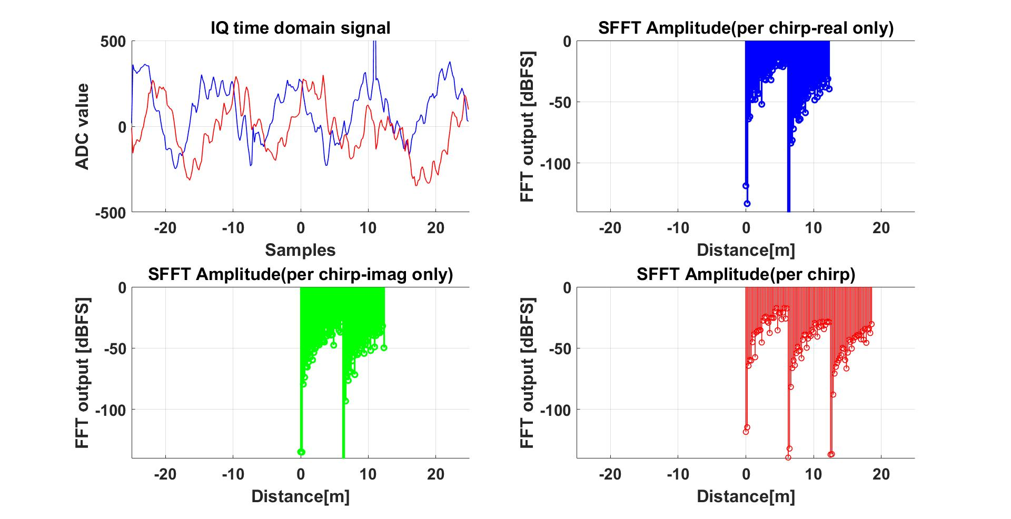
SFFT Algorithm (HAMMING window function)
Window Function on Next Slide

Slide 12
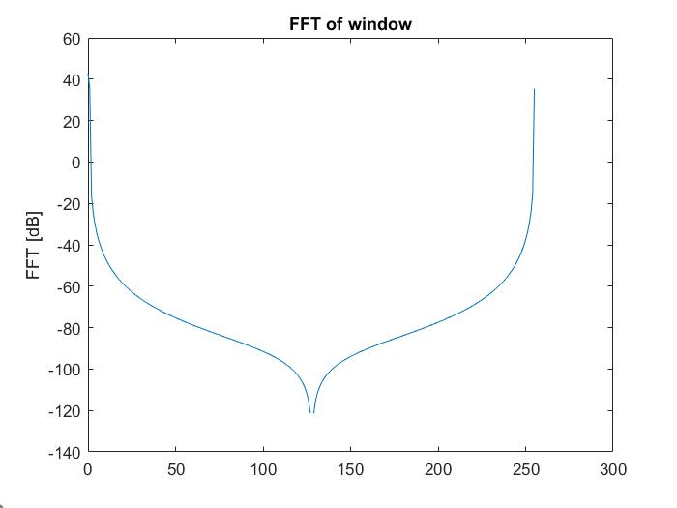
HaMming window function

Slide 13
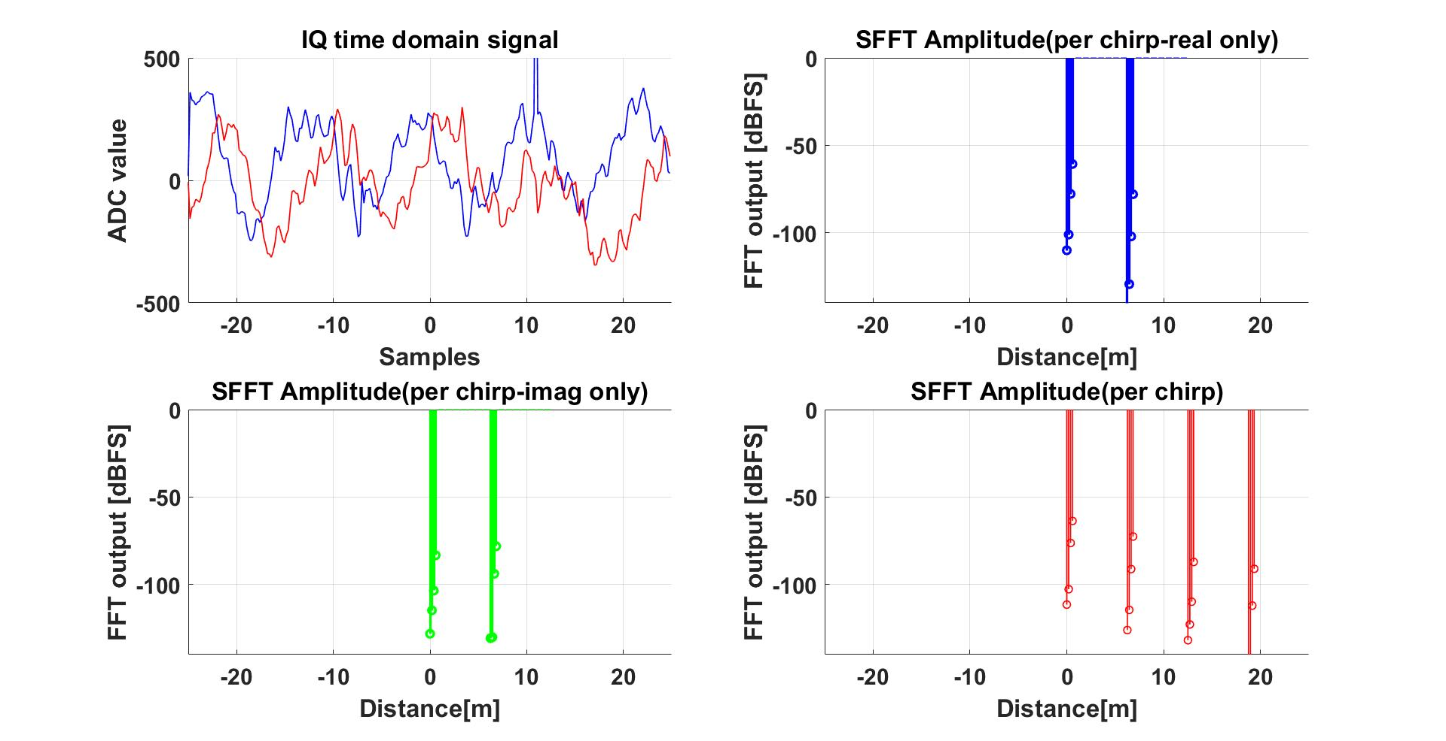
SFFT Algorithm (TAYLOR window function)
Window Function on Next Slide

Slide 14
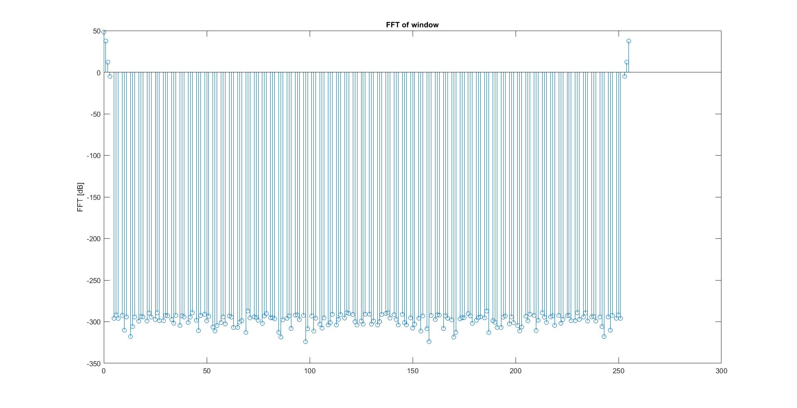
TAYLOR window function

Slide 15
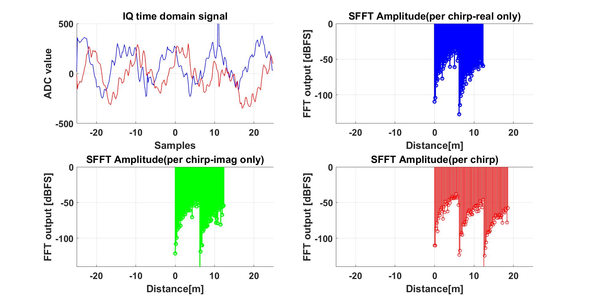
SFFT Algorithm (KAISER window function)
Window Function on Next Slide

Slide 16
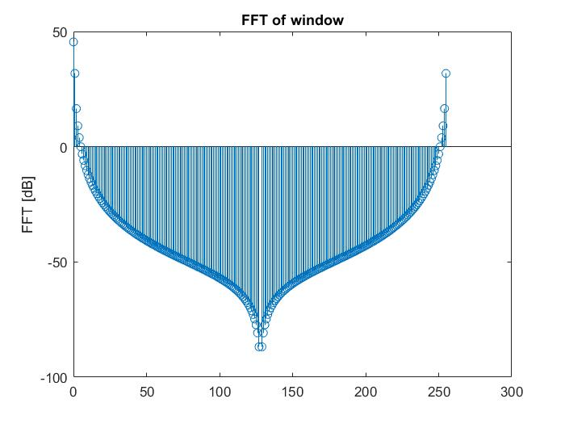
KAISER window function

Slide 17
Convoluting DOLPH CHEBYSHEV WITH BOX CAR MULTIPLE TIME
CONCLUSION – NO CHANGE IN THE STRUCTURE OF WINDOW NOR IN THE OUTPUT FFT

Slide 18
BIGBAND
TO BE IMPLEMENTED

